Slide 1
Linear Equations in Linear Algebra
SYSTEMS OF
LINEAR EQUATIONS

Slide 2
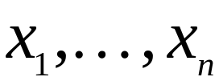
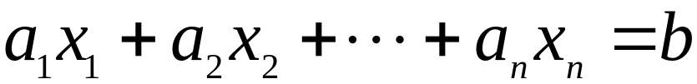
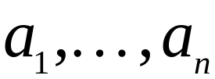
LINEAR EQUATION
A linear equation in the variables is an equation that can be written in the form
,
where b and the coefficients are real or complex numbers that are usually known in advance.
A system of linear equations (or a linear system) is a collection of one or more linear equations involving the same variables — say, x₁,…., x_{n}.

Slide 3
LINEAR EQUATION
A solution of the system is a list (s₁, s₂,…, s_{n}) of numbers that makes each equation a true statement when the values s₁,…, s_{n} are substituted for x₁,…, x_{n}, respectively.
The set of all possible solutions is called the solution set of the linear system.
Two linear systems are called equivalent if they have the same solution set.

Slide 4
LINEAR EQUATION
A system of linear equations has
    no solution, or
    exactly one solution, or
    infinitely many solutions.
A system of linear equations is said to be consistent if it has either one solution or infinitely many solutions.
A system of linear equation is said to be inconsistent if it has no solution.

Slide 5
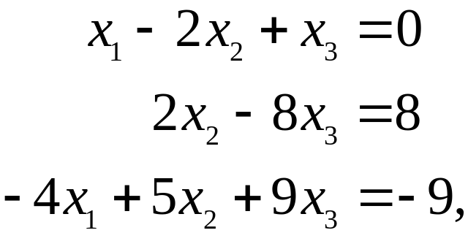
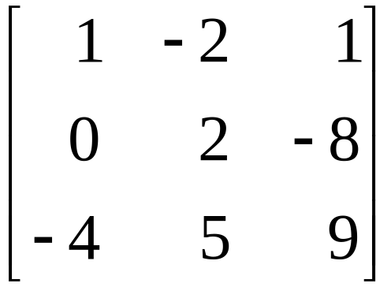
MATRIX NOTATION
The essential information of a linear system can be recorded compactly in a rectangular array called a matrix.
For the following system of equations,
the matrix
is called the coefficient matrix of the system.

Slide 6
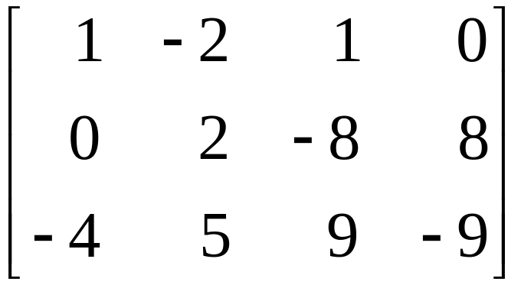
MATRIX NOTATION
An augmented matrix of a system consists of the coefficient matrix with an added column containing the constants from the right sides of the equations.
For the given system of equations,
is called the augmented matrix.

Slide 7

MATRIX SIZE
The size of a matrix tells how many rows and columns it has. If m and n are positive numbers, an m n matrix is a rectangular array of numbers with m rows and n columns. (The number of rows always comes first.)
The basic strategy for solving a linear system is to replace one system with an equivalent system (i.e., one with the same solution set) that is easier to solve.

Slide 8
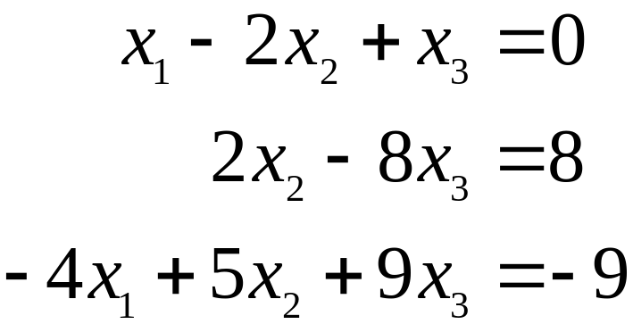
SOLVING SYSTEM OF EQUATIONS
Example 1: Solve the given system of equations.
----(1)
----(2)
----(3)
Solution: The elimination procedure is shown here with and without matrix notation, and the results are placed side by side for comparison.

Slide 9
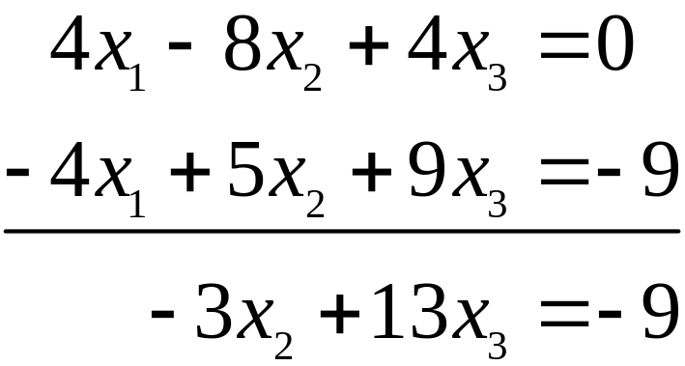
SOLVING SYSTEM OF EQUATIONS
Keep x₁ in the first equation and eliminate it from the other equations. To do so, add 4 times equation 1 to equation 3.

Slide 10
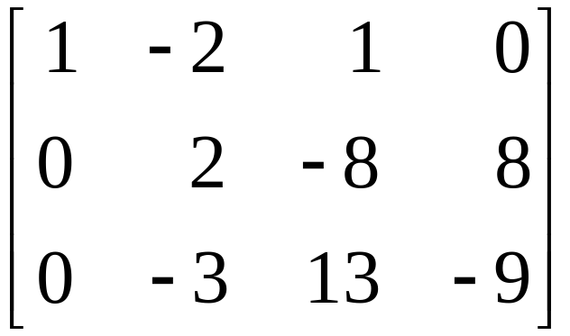
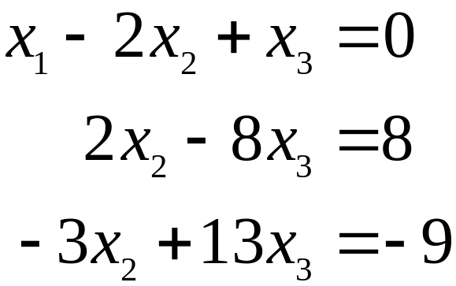

SOLVING SYSTEM OF EQUATIONS
The result of this calculation is written in place of the original third equation.
Now, multiply equation 2 by in order to obtain 1 as the coefficient for x₂.

Slide 11
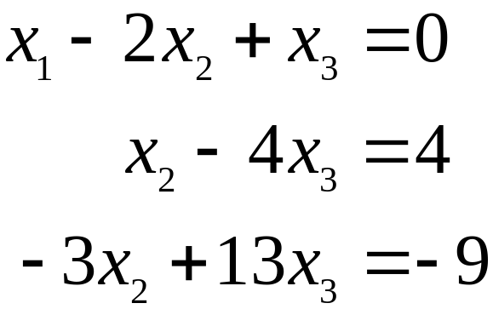
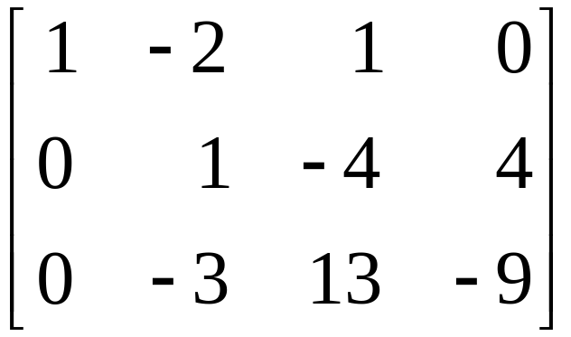

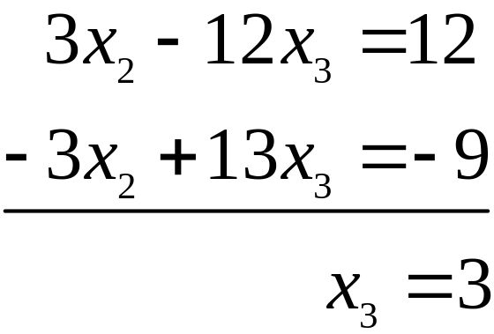
SOLVING SYSTEM OF EQUATIONS
Use the x₂ in equation 2 to eliminate the in equation 3.

Slide 12
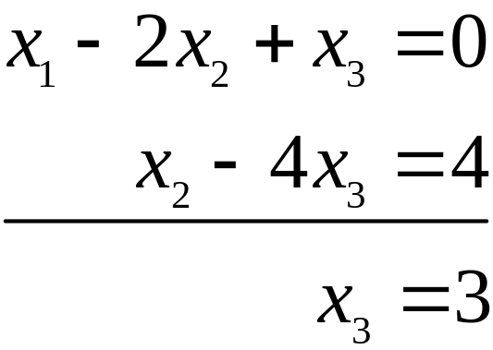
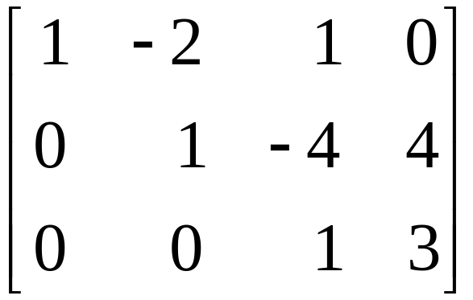
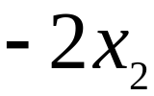

SOLVING SYSTEM OF EQUATIONS
The new system has a triangular form.
Now, you want to eliminate the term from equation 1, but it is more efficient to use the x₃ term in equation 3 first to eliminate the and x₃ terms in equations 2 and 1.

Slide 13
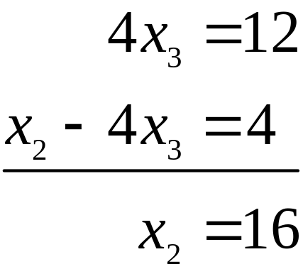
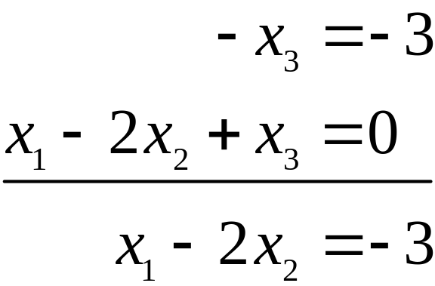
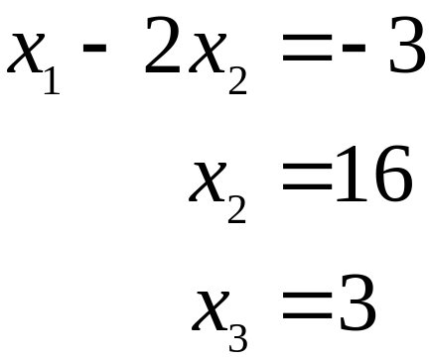
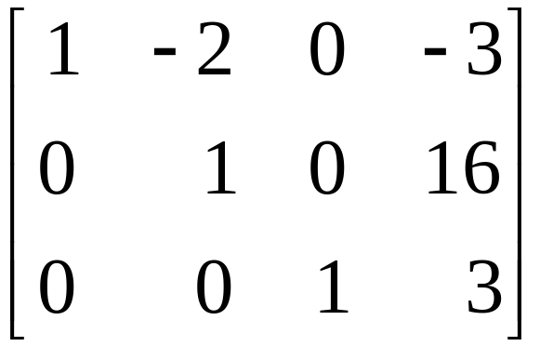
SOLVING SYSTEM OF EQUATIONS
Now, combine the results of these two operations.

Slide 14
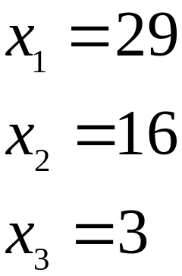
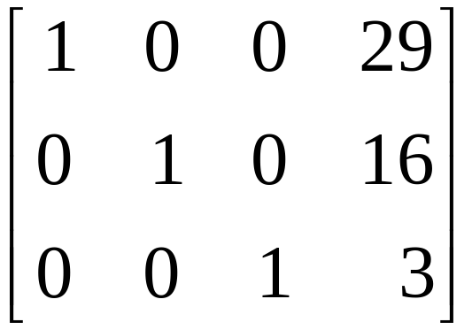
SOLVING SYSTEM OF EQUATIONS
Move back to the x₂ in equation 2, and use it to eliminate the above it. Because of the previous work with x₃, there is now no arithmetic involving x₃ terms. Add 2 times equation 2 to equation 1 and obtain the system:

Slide 15
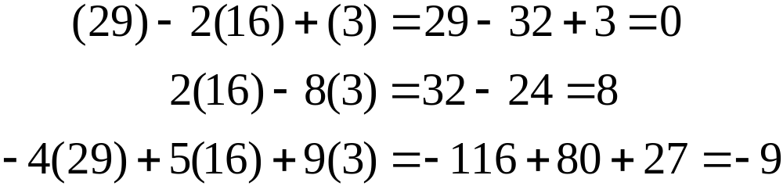
SOLVING SYSTEM OF EQUATIONS
Thus, the only solution of the original system is (29,16,3). To verify that (29,16,3) is a solution, substitute these values into the left side of the original system, and compute.
The results agree with the right side of the original system, so (29,16,3) is a solution of the system.

Slide 16
ELEMENTARY ROW OPERATIONS
Elementary row operations include the following:
    (Replacement) Replace one row by the sum of itself and a multiple of another row.
    (Interchange) Interchange two rows.
    (Scaling) Multiply all entries in a row by a nonzero constant.
Two matrices are called row equivalent if there is a sequence of elementary row operations that transforms one matrix into the other.

Slide 17
ELEMENTARY ROW OPERATIONS
It is important to note that row operations are reversible.
If the augmented matrices of two linear systems are row equivalent, then the two systems have the same solution set.
Two fundamental questions about a linear system are as follows:
    Is the system consistent; that is, does at least one solution exist?
    If a solution exists, is it the only one; that is, is the solution unique?

Slide 18
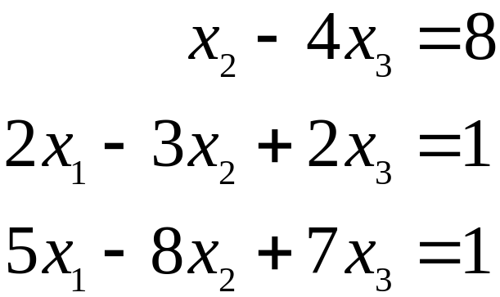
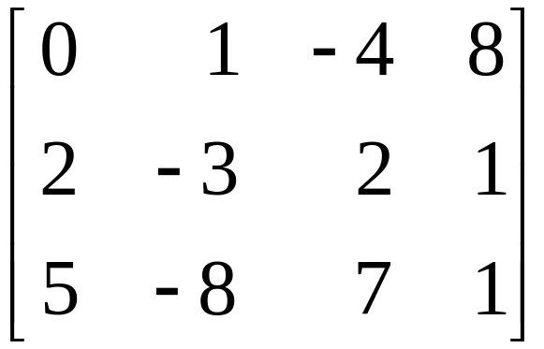
EXISTENCE AND UNIQUENESS OF SYSTEM OF EQUATIONS
Example 2: Determine if the following system is consistent.
----(4)
Solution: The augmented matrix is

Slide 19
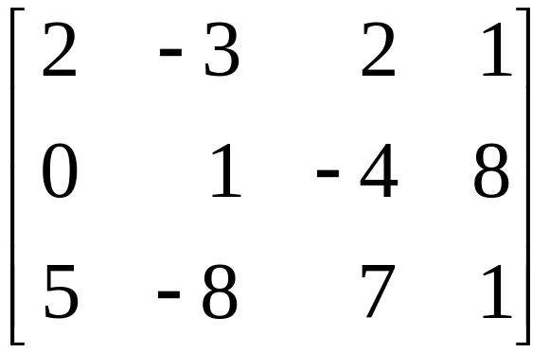

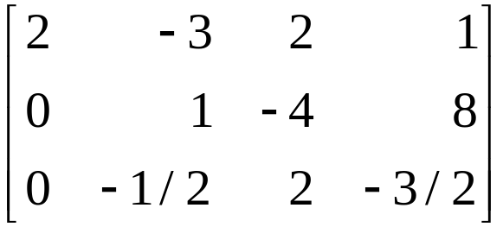
EXISTENCE AND UNIQUENESS OF SYSTEM OF EQUATIONS
To obtain an x₁ in in the first equation, interchange rows 1 and 2.
To eliminate the 5x₁ term in the third equation, add times row 1 to row 3.
----(5)

Slide 20

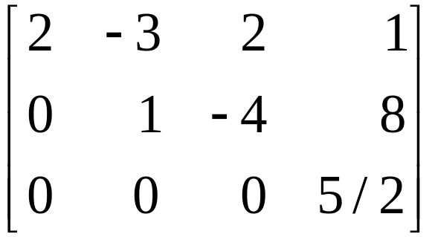
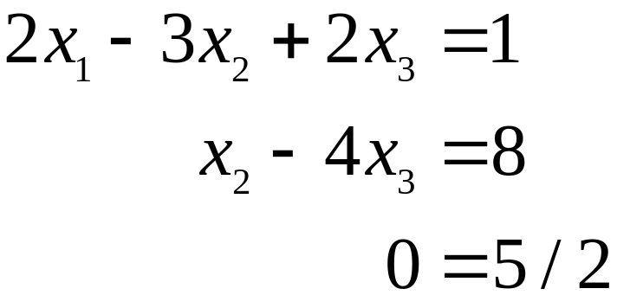
EXISTENCE AND UNIQUENESS OF SYSTEM OF EQUATIONS
Next, use the x₂ term in the second equation to eliminate the term from the third equation. Add times row 2 to row 3.
----(6)
The augmented matrix is now in triangular form. To interpret it correctly, go back to equation notation.
----(7)

Slide 21


EXISTENCE AND UNIQUENESS OF SYSTEM OF EQUATIONS
The equation is a short form of
There are no values of x₁, x₂, x₃ that satisfy (7) because the equation is never true.
Since (7) and (4) have the same solution set, the original system is inconsistent (i.e., has no solution).

